Slide 1
THE PERFORMANCE IMPROVEMENT FUNDS
AND
EDUCATIONAL COLLABORATIONS
The Emerging Approach at UB

Slide 2
THE INTERDISCIPLINARITY OF EMERGING OPPORTUNITIES
  Niche programs responding to emerging educational needs in NYS and beyond tend to cross disciplinary boundaries and have multiple potential “homes” across campus. Data analytics programs, for instance, are housed in business schools, engineering schools, schools of arts and sciences, continuing education units, or even their own interdisciplinary centers. The programs may draw faculty from across these units.
—Educational Advisory Board
  OBSERVATION: Colleges and universities need facilitating mechanisms and innovation support strategy teams to manage the intellectual, cultural and financial challenges of cross-school and discipline collaborations.

Slide 3
EDUCATIONAL COLLABORATIONS COMMITTEE
Lessons
Reaching and documenting shared agreement is essential—avoids “downstream” conflict
Need clear support of deans from all schools involved at the outset—objective, process, representation
Program/course/unit duplication can be challenging—managing situations where there is comparable expertise in different units
The facilitating team can not take sides
Need equitable unit representation in project teams
The “AND” proposition of faculty representation—balancing unit interests AND the aims of the larger collaboration
Many programs seek a diversity of stackable credentials that may or may not lead to a traditional degree depending on the individual learner’s need
An organizational model is emerging for multi-school educational programs

Slide 4
PIF—$1.9M
Catalyst for Educational Collaboration and Innovation Support
ICDS
Institute for Computational and Data Science
Project # 281
$660,000
INNOVATION SUPPORT TEAM (C.Kroll)
MOOCS for credit and non-credit (stackable modules toward credentials)
Project # 282
$25,000
Project # 285
$413,000
Project # 280
$420,000
CDI
Center for Diversity Innovation
IGL
Institute for Genomic Literacy
(Genetic Counseling)
Project # 276
$25,000
BS-ITM
Information Technology in Management
Project # 275
$311,000

Slide 5
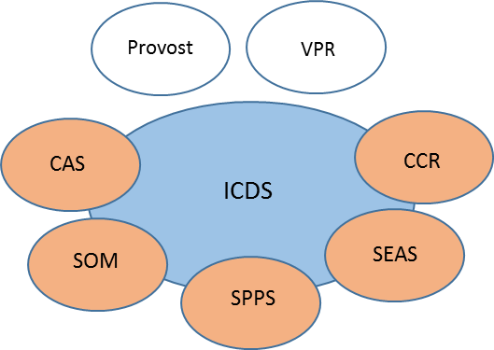
The Institute for Computational and Data Science
Vision
Vision:
ICDS will be an international leader in creating, curating and disseminating data and computing related knowledge and skills and provisioning such services for UB, SUNY, WNY and all the communities therein.
Establish an Institute* of Computational and Data Sciences (ICDS) by integrating UB’s strong interdisciplinary graduate program in Computational Data Sciences & Engineering (CDSE) with UB’s nationally recognized computing/data infrastructure provider Center for Computing Research. ICDS will create:
Novel and integrated educational and training offerings ranging from research oriented PhDs to skills oriented continuing education to meet data/computing workforce needs of the region and the nation;
New breed of data/computing leaders who internalize data and computing driven methodologies in their thinking and transform workflows for scientific discovery, business decision making, innovation and product development;
The new methodologies and tools for the convergence of data, computing and artificial intelligence to transform scientific investigation and innovation;
A template for SUNY wide use for integrated interdisciplinary programs in student-centric and just-in-time learning.
Industry
Govt.
Who Are We?
A PhD program in Computational Data Sciences was established at UB in 2014 and approved by SUNY/State Ed. In 2015. Program has established itself well with over 10 students, 40+ associated faculty and 20+ funded projects.
CCR is among the leading providers of academic computing research infrastructure in the nation with extensive NSF and State funding in addition to university investments.
Need Analysis
Massive gap in availability of ;
Data analytics, AI and computing professionals (~190,000* per year)
Data driven methodology aware professionals in sciences, engineering and business(~2,500,000*)
“To meet this explosive demand … Higher Education needs to be nimble and responsive and its bachelors, graduate, certificate and executive programs need to be responsive …” IBM, “The quant crunch”, July 2017
Academic Programs
Modules in core skills and concepts e.g. Introduction to R; Apache Spark, Machine Learning Fundamentals …
Professional stream capped by MPS integrating skills & theory awareness.
PhD program at apex grounded in theory and domain knowledge.
Participation and Governance Structure
Core leadership comprises of executive layer of Deans & VPR providing oversight to Director of ICDS;
Unit directors and functional area directors are responsible for areas.
Integrated multidisciplinary structure drawing on a diverse pool of talent to deliver the best in research, teaching and training.
“One-stop” shop for stakeholders needing computing and data services and infrastructure.
CDSE
CCR
ICDS
Modules
“JIT” skill oriented components
PhD
Apex degree - theory focused with high end skills
Theory aware, practice oriented, terminal masters degree
MPS
Certificates
Ensembles of modules in market oriented focus areas
A successful ICDS will deliver a dynamic and adaptive unit that provides UB and SUNY the best of a department, an organized research unit and research computing infrastructure, supporting all current functionality in leading edge research, graduate education and computing/data research infrastructure provision while enabling continuing and just-in-time education , and, services/consultancy.
* Institute designation enables the balanced offering of interdisciplinary teaching and research content and access to data/computing infrastructure along with the ability to dynamically bring in external partners (like other SUNY institutions, private companies and non-profits like the Open Data initiative) and necessary expertise.
# Source: Mckinsey Study 2011; Corroborated by BLS’ broader categories employment forecasts. Updated qualitatively in National Strategic Computing Initiative executive order 2015.

Slide 6
AN EMERGING MODEL
PIF and the Institute for Computational and Data Science (ICDS)
A $1.1M Innovation Start-up
PIF AWARDS
MOOCS for Credit
($413K)
Stackable Curriculum
Modules for Development
($40K)
Institute for Computational
Data Science (ICDS)
($660K)
School/Partner Leadership Team
Liesl Folks, Admin. Lead
Robin Schulze
Michael Cain
Jean Wactawski-Wende
Jim O’Donnell
Paul Tesluk
___________________
VPR Rep - Tom Furlani (partner unit)
Innovation Support Team
Strategy Team
Business Officer Team
Christine Kroll, Convener
Tim Leyh
Lisa Stephens
Beth Fellendorf
Katie Darling
Elaine Cusker
Anne Reed
Jessica Clemons
Abani Patra, Director
Gino Biondini
Sanjukta Smith
Tom Furlani
Scott Doyle
Mark Kiviniemi
Kathy Boje
Bill McDonnell, Convener
Joe Kerr
Kristin Gniazdowski
Mike Redfern
Sandy Drabek
Ken Suski
MA in Data Science and Online/Non-traditional Learners
MPS in Data Sciences and Applications
New and advanced Tech Education (e.g. Blockchain)
Stackable modules for credentials, micro degrees in data science skills areas
PhD program in CDS
Work for Others (e.g. SEAS MS in Eng Science (Data Sci)

Slide 7
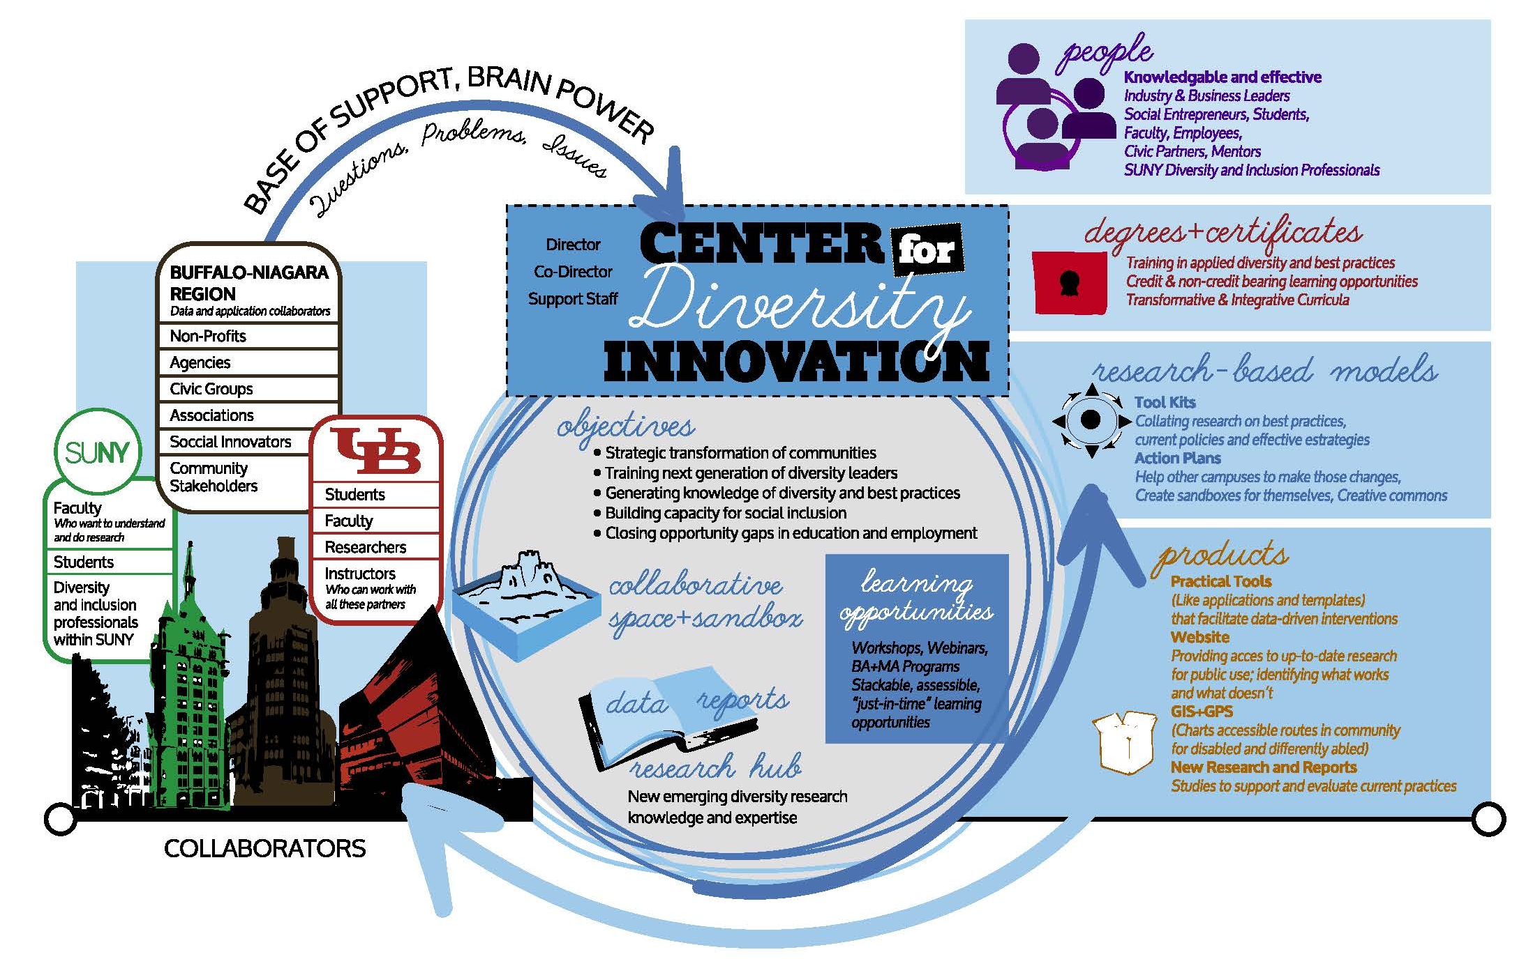
CENTER FOR DIVERSITY INNOVATION (CDI)
Vision
NOTE: All 12 academic units are involved in this initiative

Slide 8
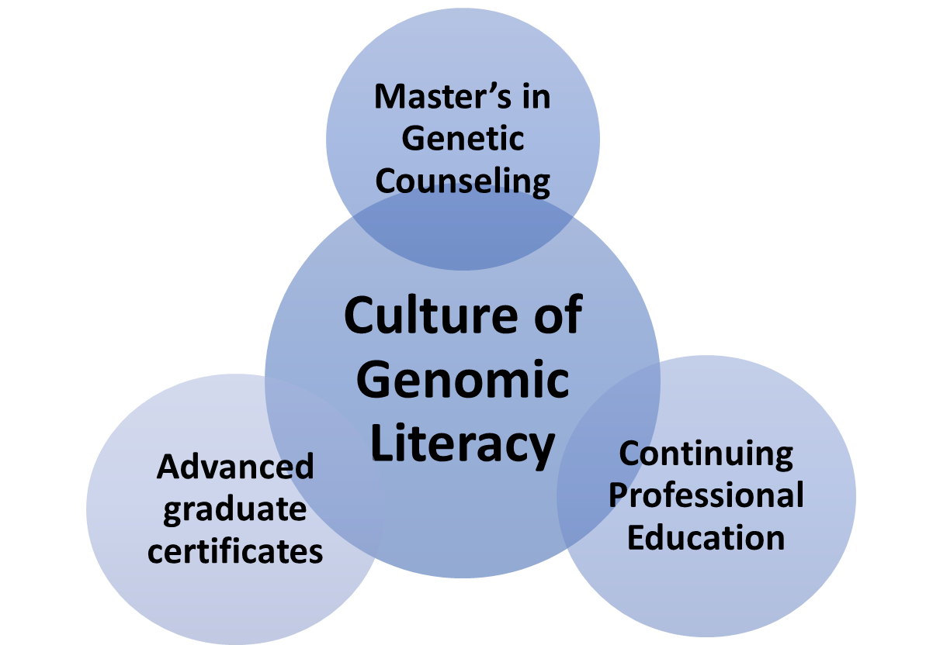
INSTITUTE FOR GENOMIC LITERACY (IGL)
Genomic Literacy: a broad exploration of science, humanity, identify, ethics and justice. Program and course development for three interrelated initiatives will be performed in parallel. Throughout, there will be a collaboration between the sciences, arts and humanities. This model will be exportable throughout SUNY, making New York a destination for developing genomic literacy.
Patient advocacy
Community Engagement, Public Policy & Integrated Clinical Practice
Community
engagement
4 tracks for students in: - liberal arts
-healthcare
-education
-science communication
Continuing education and interprofessional education (Medicine, Nursing, Pharmacy, Education, Law, Social Work)
Online modules
and resources

Slide 9
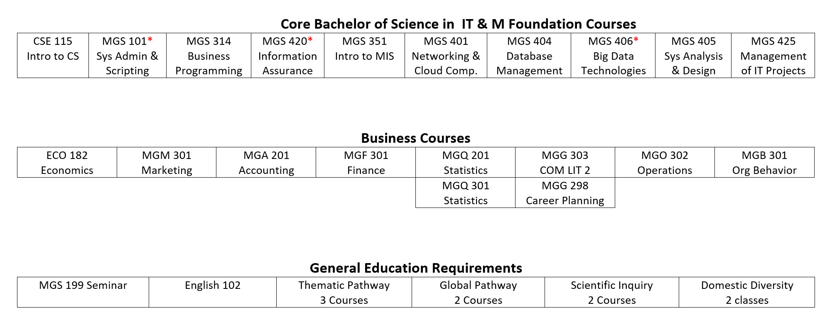
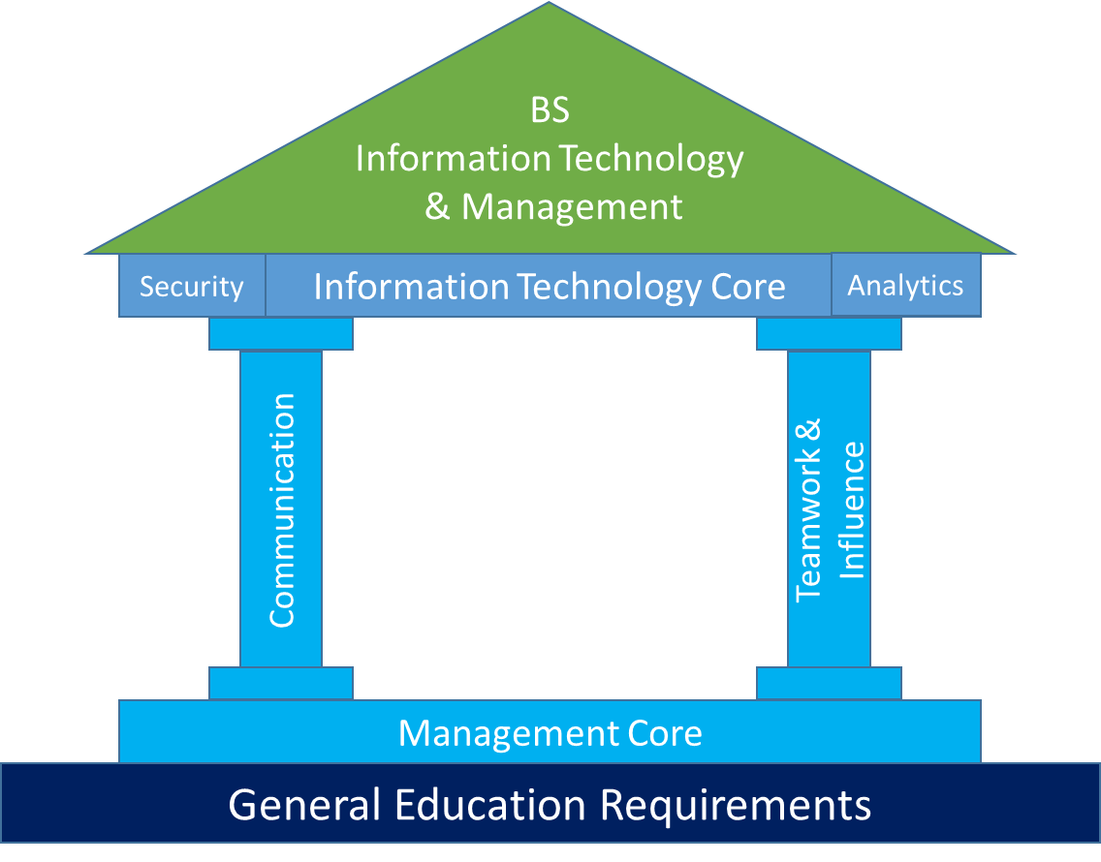
THE BS PROGRAM—INFORMATION TECHNOLOGY AND MANAGEMENT
Objectives
Overarching Objective: Create, launch and scale a new Bachelors of Science in Information Technology and Management (BS in IT&M), an innovative curriculum that develops proficiency in essential IT and business areas that helps to meet the growing high-tech workforce demands of the state, grows student enrollment, increases completion rates, and supports successful student experiences.

Slide 10
THE NEUROSCIENCE INITIATIVE
Mission
Provide educational offerings that close a gap at UB preventing the university from recognition as the destination, locally, nationally and globally for the study of neuroscience. These offerings also respond to growing career opportunities in academe, in health professional areas and in the global neuroscience industry
An undergraduate minor in neuroscience that exposes students to content that would provide skills for careers in the following areas
    Professional biomedical careers
    Academic and industry based research (MS/PhD)
    Scientific writing
    Patent attorney
    Science policy
A BS program in neuroscience extending preparation for careers in the above mentioned areas. The program explores the cellular mechanisms and physiology of the diseased and normal functioning of the central nervous system and how such mechanisms create behaviors and interactions in their environment

Slide 11
UB CENTER FOR THE ADVANCEMENT OF SPORT
Vision
Enable strategic marshaling of resources to foster communication, cooperation and research in management, medicine, athletics, education, public health and law, channeling Buffalo’s passion for sports to create a multi-faceted educational enterprise to drive excellence in athletics, education, business and wider community
CAMPUS PARTNERS
MANY PATHWAYS
Law
Medicine
Public Health
Management
Education
Division of Athletics
BA Law w/ Sports Administration Minor
JD or MLS Sports Law
JD/EdD Sports & Education Administration
JD/MD Sports Medicine
JD/MS Law & Community Health & Health Behavior
BA/MS Law and Athletic Training
3+2
JD/MBA Sports Law & Management

Slide 12
THE UB CENTER FOR THE ADVANCEMENT OF SPORT
The Concept
WNY Sport Ecosystem
The Center
Law
JSMBS
SPHHP
SOM
GSE
Athletics
Amateur Sports
Professional Sports
Pegula Sports & Entertainment
Delaware North
18 professional/semi-professional teams, e.g.
      Bills
      Sabres
      Beauts
      Bandits
      Bisons
      FC Buffalo
Colleges
High schools
Club sports
Town/local sports
Community/Non-Profits
Wilson Foundation
Oishei Foundation

Slide 13
SUSTAINABILITY
An Advanced Graduate Certificate
PROGRAM MISSION
This Advanced Graduate Certificate prepares students to help organizations adopt sustainable practices and develop plans to minimize environmental impact. The program fosters interconnections between disciplines and considers sustainability through multiple lenses: economics and business; social sciences and cultural studies; and science and engineering.
By the completion of their studies in the proposed advanced certificate program in Sustainability, students are expected to demonstrate the following primary learning outcomes:
  Identify and analyze the scientific, social, environmental, and economic dimensions of sustainability;
  Develop a capacity for integrative systems thinking and practice;
  Apply sustainability metrics and be able to interpret data on the environment and ecosystems.
INVOLVED UNITS
College of Arts and Sciences
  Robert Adelman
  Sean Bennet
  Howard Lasker
  Adam Rome
School of Architecture and Planning
  Nicholas Rajkovich
School of Engineering and Applied Sciences
  John Atkinson
  Alan Rabideau
School of Management
  Debu Talukdar
UB Renew Institute
  Zia Ahmed
  Susan Clark
  Michael Shelly
Project Convener, Katherine Ferguson

Slide 14
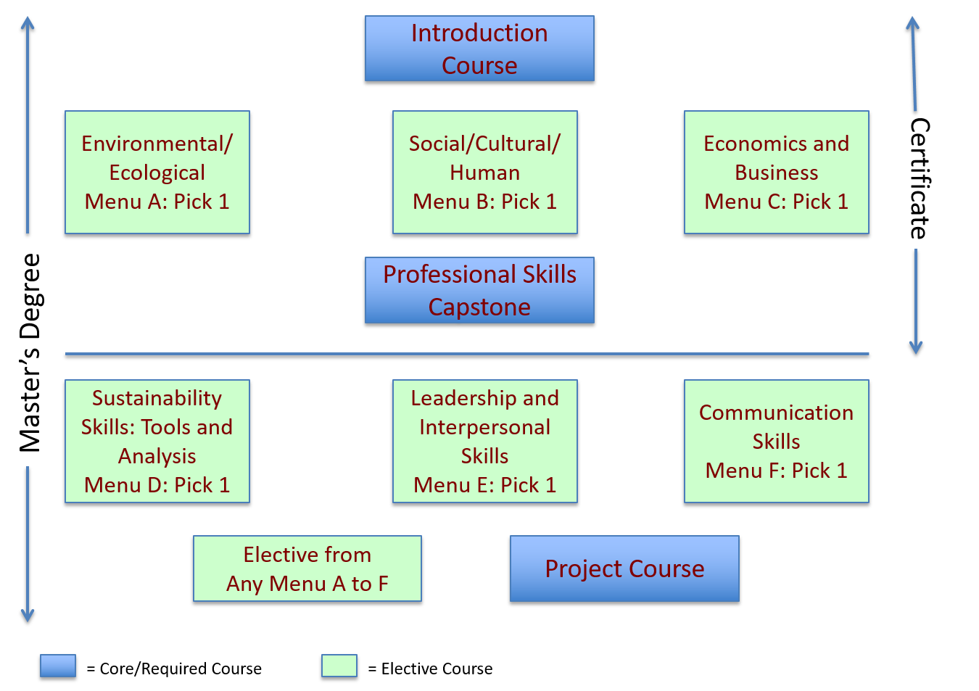
GRADUATE DEGREES IN SUSTAINABILITY

Slide 15
A NEW BIOINFORMATICS PROGRAM
One View
Bioinformatics
Biology
Computer Science
Statistics
“use of computation and statistics to gather, store, analyze, interpret, and integrate data to solve biological problems”
—Sainani, Biomedical Computation Review, Fall 2015 p.13
“the collection, classification, storage, and analysis of biochemical and biological information using computers especially as applied to molecular genetics and genomics”
—Merriam-Webster

Slide 16
A NEW BIOINFORMATICS PROGRAM
Another View
EDCC Resolution—A four track program that reconciles the two perspectives: Biology, Statistics, Computer Science and Biomedical Informatics

Slide 17
GLOBAL HEALTH
Framework for Program Development
The strategy for undergraduate and graduate program expansion is to develop “stackable” credentials—packaging existing and newly developed courses into micro-credentials, which, in turn, can be aggregated into degree programs (diagram below). This larger strategy includes several complementary tactics, such as: (1) developing lynchpin dual-listed (400/500 level) courses, (2) enabling ample flexibility for elective coursework, e.g., independent study abroad, and (3) identifying courses (and instructors) with the capacity to transform the modality of delivery, e.g., online, asynchronous, off-site, and other formats.

Slide 18
CENTER FOR ADDICTION EDUCATION AND AWARENESS
PROGRAMS
APPROACHES
Undergraduate Minor in Addiction Studies
Undergraduate Certificate in Addiction Studies (with and without CASAC Credential)
Interdisciplinary MA in Addiction Studies (with and without CASAC Credential)
Residency Training
Professional Training – Continuing Education
Community Engagement and Education
Team teaching
IPE collaborations
Cross-listed courses
Tap community expertise
Notes:
Anne
Key Talking Points:
Need more flexible and responsive models to establish, and realize our full institutional potential
We’re stronger when working together to leverage pockets of innovation in schools
The bullet points illustrate the elements of successful models
(walk through the bullets?)

Slide 19
INSTITUTE FOR PUBLIC AND NON-PROFIT LEADERSHIP
Mission
The Institute will design and deliver a comprehensive array of leadership and organizational development programs targeted to the public and non-profit sector needs of WNY
Build stronger multi-agency/organizational networks and greater collaboration within and across public and non-profit sectors
Engage diverse UB strengths in delivering Institute program and in building more robust relationships with public and non-profit sectors
Offer joint programming in collaboration with regional public and non-profit organizations
Notes:
Anne
Key Talking Points:
Need more flexible and responsive models to establish, and realize our full institutional potential
We’re stronger when working together to leverage pockets of innovation in schools
The bullet points illustrate the elements of successful models
(walk through the bullets?)

Slide 20
INSTITUTE FOR PUBLIC AND NON-PROFIT LEADERSHIP
Potential Areas of Focus
Strategic planning
Entrepreneurial thinking and innovation in government and nonprofit sector
Organizational and systems change
Design thinking
Building effective collaborations and successful partnerships
Public and nonprofit financial management
Operational excellence (project management, lean, total quality, customer-centricity, root cause analysis)
Data analytics and decision making
Cybersecurity and information assurance
Marketing and communications
Strategic development and management of talent
Creating and leading effective teams
Employee engagement
Workplace diversity and inclusion
Note: These are proposed topics; specific leadership and organization competencies to be addressed in the Institute will be determined from a comprehensive needs assessment of the regional public and nonprofit sectors
Notes:
Anne
Key Talking Points:
Need more flexible and responsive models to establish, and realize our full institutional potential
We’re stronger when working together to leverage pockets of innovation in schools
The bullet points illustrate the elements of successful models
(walk through the bullets?)

Slide 21
OTHER EMERGING INITIATIVES
New Proposals
37 joint degree programs
3+2—UB Teach—CAS/GSE
3+3—CAS/LAW
3+2—CAS/MPH
30 micro credentialing programs
Developing Initiatives
  Digital Humanities
  Applied/Interdisciplinary Mathematics
  Math/Economics/Finance Collaboration
  Innovation Led Human Development/Developmental Engineering
  Entertainment Technologies
  Medical Spanish
  Social Design AGC
  Professional Writing AGC
  Chemistry Entrepreneurship
  Clean Energy Workforce Development
  Health Navigator Certificate Program
  CPR Training Certificate
  Certificate and micro credentialing opportunities in Law (e.g., Higher Education Law, Technology Law, etc.)
Notes:
Anne
Key Talking Points:
Need more flexible and responsive models to establish, and realize our full institutional potential
We’re stronger when working together to leverage pockets of innovation in schools
The bullet points illustrate the elements of successful models
(walk through the bullets?)

Slide 22
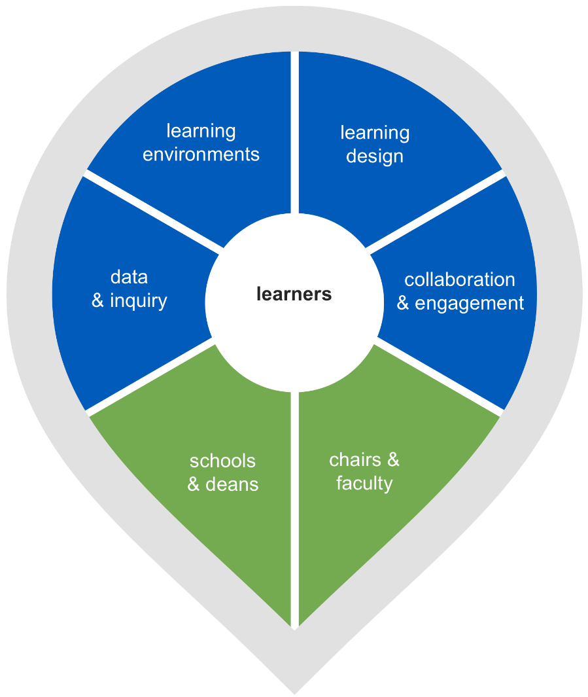
CENTER FOR EDUCATIONAL INNOVATION
Mission 2018+
The Center for Educational Innovation (CEI) partners with university deans and faculty to positively impact student learning outcomes through the ongoing discovery and application of evidenced-based pedagogy and the exploration of educational innovations.
Research
Innovation
learners
Notes:
Values
The Center for Educational Innovation (CEI) values open collaboration and sharing with faculty and learners to increase our institutional knowledge in academic innovation.

Slide 23
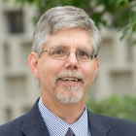
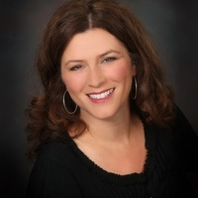
THE CENTER FOR EDUCATIONAL INNOVATION
New CEI Signature Program
Teaching Observation Program
  Evolve our culture of excellence in teaching while increasing interactions throughout our interdisciplinary community of practice
  Lead Faculty Fellows will work with CEI to oversee on-campus and online teaching observation programs
  Additional Faculty Fellows will be recruited to expand the reach of the program via invitations to Chancellor awardees, distinguished teaching faculty, Dean and Chair recommendations
  UB will be one of the few AAU centers utilizing faculty as our primary teaching observation reviewers
CEI Lead Faculty Fellow, On-Campus
CEI Lead Faculty Fellow, Online
James N. Jensen, PhD
Professor
Director of Undergraduate Studies
Environmental Engineering
School of Engineering and Applied Sciences
Deborah A. Moore-Russo, PhD
Associate Professor, Mathematics Education
Department of Learning and Instruction
UB Graduate School of Education
Notes:
Anne
Key Talking Points:
Need more flexible and responsive models to establish, and realize our full institutional potential
We’re stronger when working together to leverage pockets of innovation in schools
The bullet points illustrate the elements of successful models
(walk through the bullets?)

Slide 24
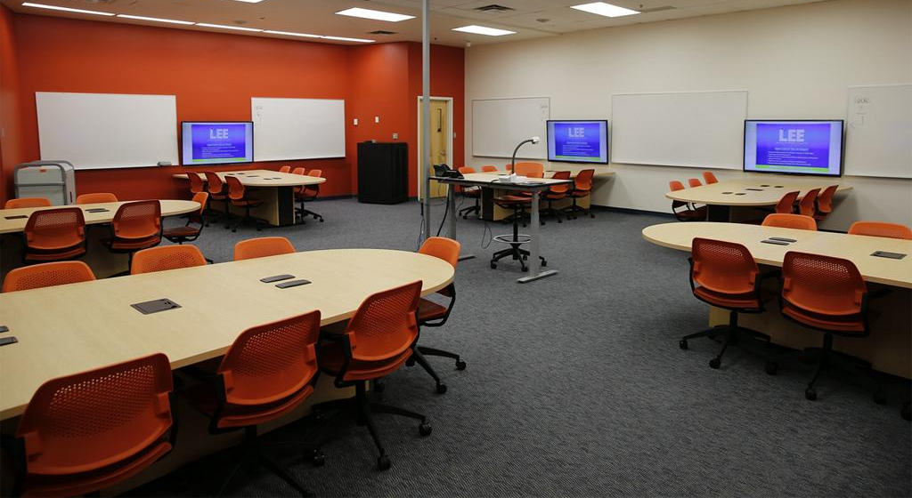



FACULTY COLLABORATION STUDIO
The learning design studio will serve as the University's innovative pedagogical and learning design research, think tank, and teaching experimentation hub. The Studio provides a dedicated professional space for faculty to collaborate, create, design and experiment with innovative pedagogical models, program learning designs, and act as a flexible think tank environment to work across disciplinary areas.
CEI Stewardship
CEl staff will provide stewardship of the space alleviating school-based funds from room maintenance and scheduling activities.
Faculty Focused Design Studio
Faculty Focused Design Studio Faculty will participate in multidisciplinary collaborations, research, and ongoing development within the Studio, designed for:
• engaging participants before and after sessions via the "Warm up, Cool down" space
• connecting colleagues, experts, and learners located anywhere through the interactive connected web conferencing system
• capturing work sessions, notes, and outcomes using the 360 global view cameras • capturing work sessions, notes, and outcomes using the 360 global view cameras
• providing access to specialized camera capture/coding software to perform future analysis of think tank outcomes or pedagogical innovation experiments (CEl will include the annual licensing of -$6,000 per year in budget to maintain this camera capture/coding software)
• video capturing capability for the creation of instructional content for learning management delivery, mooc creation, etc.
• observing participants engaged in work sessions, innovative pedagogical experiments, and unique learner design configurations via a place-based or virtual delivery using the studios one-way windows
• custom workshops, webinars, and share sessions supporting teaching, learning, and research design initiatives
Dedicated professional space for faculty to collaborate, create, design & experiment with:
innovative pedagogical models
program learning designs
engage in a community of practice act as a flexible think tank environment to work across disciplinary areas.
Notes:
Get pix from Rebecca and show this at the end to end everything on a great note before discussion

Slide 25
BUILDING THE INFRASTRUCTUREE
Creating the Faculty Studio
  400k in university investment; $200k PIF investment
    MOOC production facility
    Collaboration space
    Workshops—building faculty innovation capacity
    Research in pedagogical innovation
    A SUNY Center for best-practice educational experimentation
Staffing the Innovation Support Team—PIF and University match
  1 learning design team leader—$70k
  3 instruction designers—$140k
    Learner-centered design
    Evidence-based best practice
    Innovative pedagogy
    Active classroom strategy
    Interactive online development

Slide 26
CONCLUSION
There is great energy within the units to build interesting responsive interdisciplinary educational offerings responsive to emerging learner demand
UB is seeking to build a durable, replicable organizational model to enable emerging cross-disciplinary collaboration catalyzed by PIF funding
UB is creating a skilled innovation support team (although a long way from peer norms) to develop new pedagogies, provide new learning environments and effective partnerships with units and their faculty that enable effective educational opportunities
Creating an Academic Innovation function will set in place the longer-term organizational framework that will enable us to scale our response as additional initiatives mature
UB can export this approach across the region in SUNY and around NYS
Notes:
Anne
Key Talking Points:
Need more flexible and responsive models to establish, and realize our full institutional potential
We’re stronger when working together to leverage pockets of innovation in schools
The bullet points illustrate the elements of successful models
(walk through the bullets?)

